Slide 1
Five Day Trip to Ireland
15th - 19th May 2020
Saša Jeličić 8.a

Slide 2
Day 1: Friday 15/05/2020
Transport from Beli Manastir to Budapest Airport (3h): €20pp / €40 total
Flight Budapest – Dublin (3h): €79pp / €158 total (www.ryanair.com)
Transport from Dublin Airport to Dublin city centre (30min): €7pp / €14 total (https://www.dublinpublictransport.ie/dublin-airport-bus)
Check-in to the apartment
Dinner
Walk around Temple Bar, Grafton Street, St Stephen’s Park

Slide 3
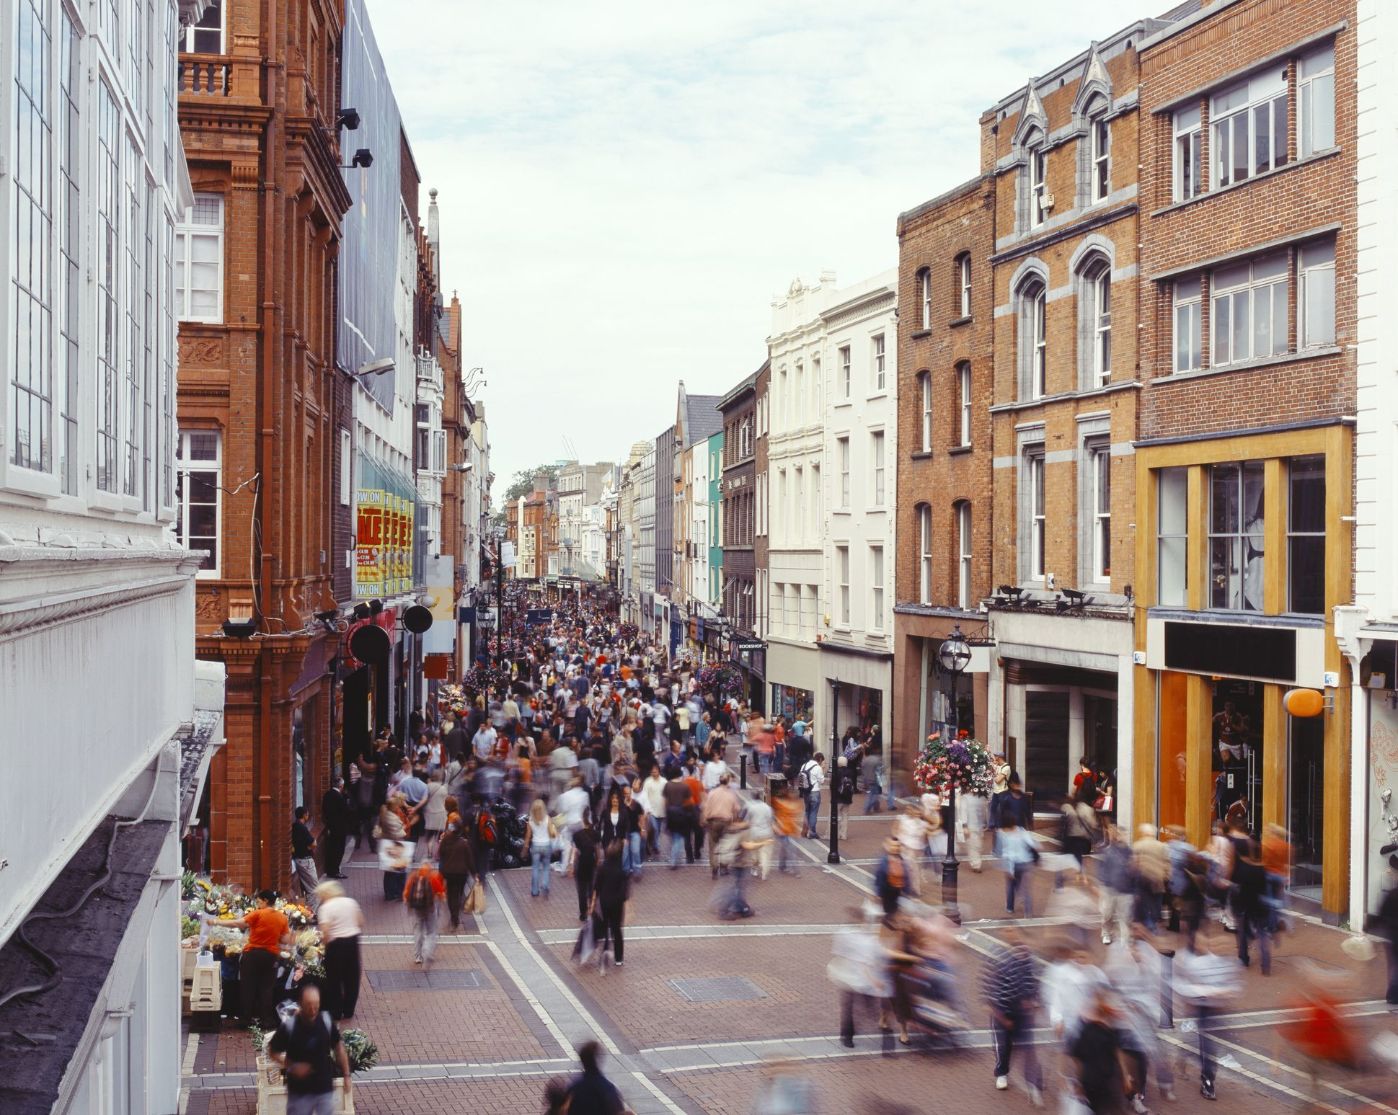
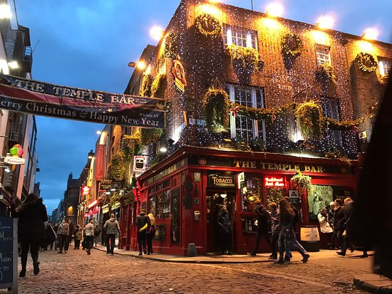
Temple Bar & Grafton Street

Slide 4
Day 2: Saturday 16/05/2020
City Sightseeing Dublin Hop-On Hop-Off Bus Tour (audio tour commentary): €22pp / €44 total (https://www.tripadvisor.ie/AttractionProductReview-g186605-d11448079-City_Sightseeing_Dublin_Hop_On_Hop_Off_Bus_Tour-Dublin_County_Dublin.html)
Dublin Castle Guided Tour: €6pp (child ticket) / €12 total (https://www.dublincastle.ie/tickets-and-times/)
Christ Church Cathedral and Dublinia Viking Museum: €18pp / €36 total (https://www.dublinia.ie/plan-your-visit/prices-and-tickets/)
Lunch
Trinity College Dublin: free
The Book of Kells and the Old Library Exhibition: €11pp / €22 total (https://www.tcd.ie/visitors/book-of-kells/tickets-information/)
National Museum of Ireland – Archaeology: free (https://www.museum.ie/en-IE/Museums/Archaeology)
Dinner

Slide 5
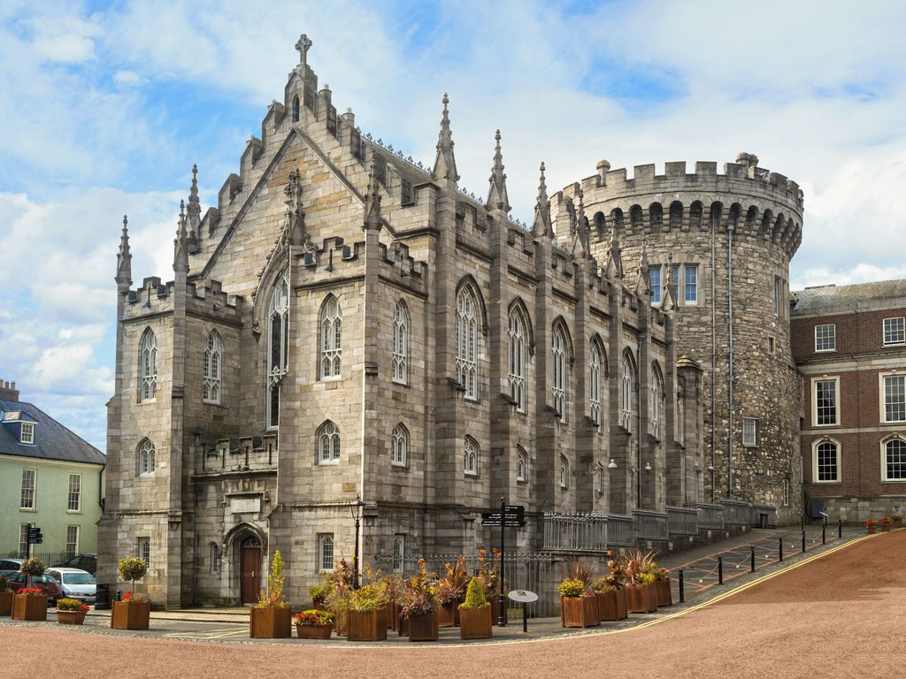
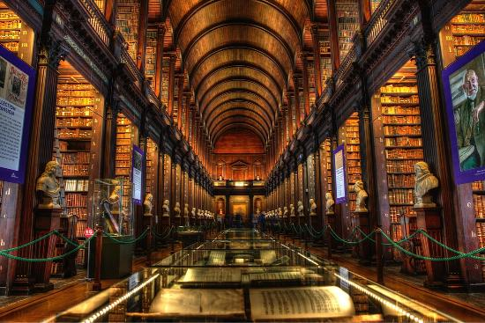
Dublin Castle & The Book of Kells

Slide 6
Day 3: Sunday 17/05/2020
All Day Cliffs of Moher Tour Including Wild Atlantic Way, The Burren and Galway City: €55pp / €110 total
(https://www.viator.com/en-IE/tours/Dublin/Cliffs-of-Moher-Tour-Including-Wild-Atlantic-Way-and-Galway-City-from-Dublin/d503-5300MOHER)

Slide 7
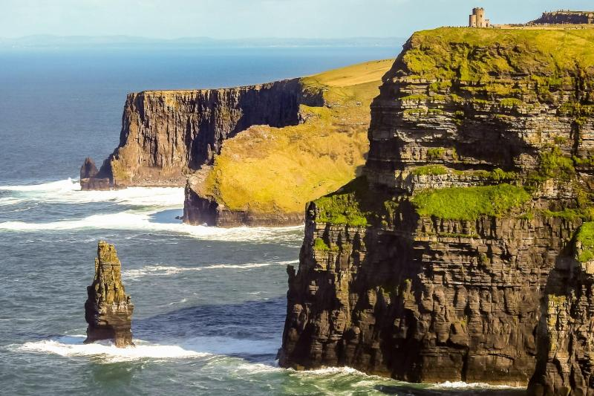
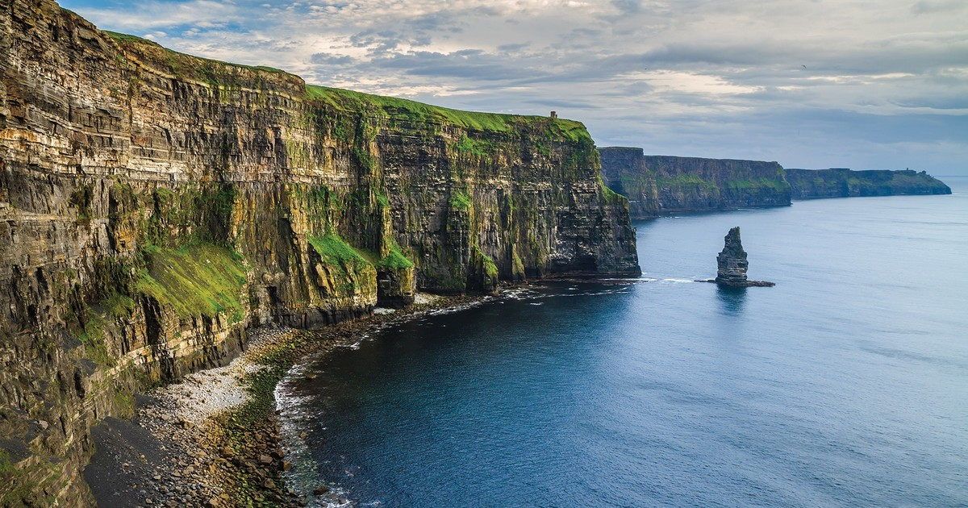
Cliffs of Moher

Slide 8
Day 4: Monday 18/05/2020
Howth Summit, Howth Cliff Walk, walk around village, pier, food market: free (https://www.tripsavvy.com/howth-cliff-path-loop-1541626)
Lunch
Malahide Castle and Park: €12pp / €24 total (https://www.malahidecastleandgardens.ie/book-tickets/)
dinner

Slide 9
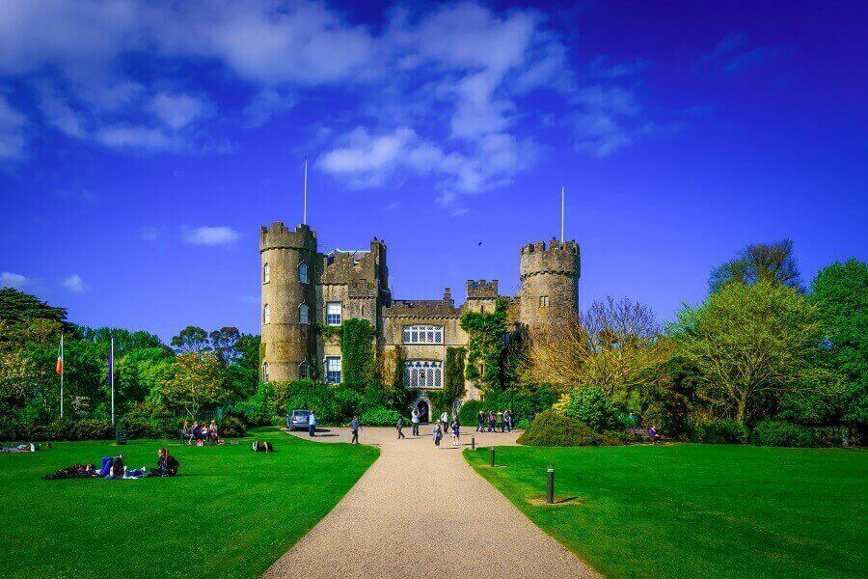
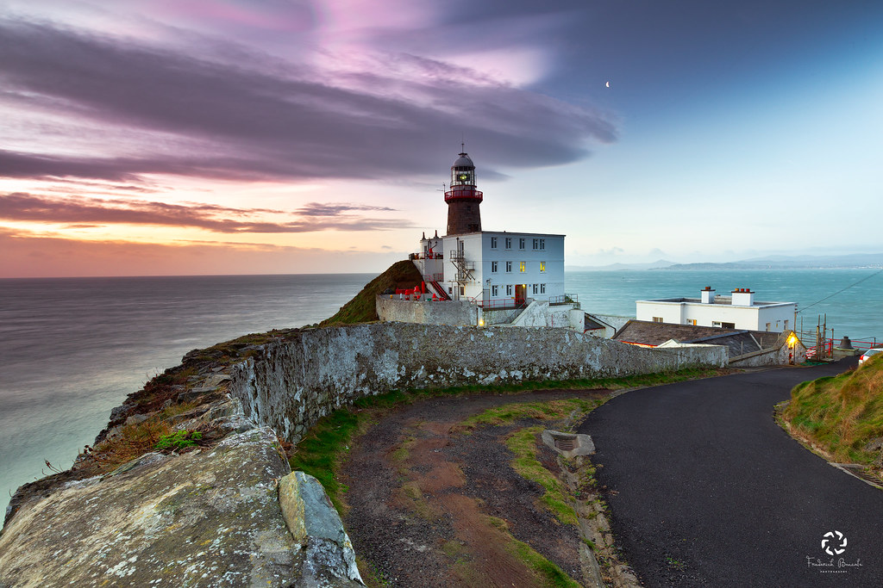
Howth Summit & Malahide Castle and Park

Slide 10
Day 5: Tuesday 19/05/2020
Bray beach and pier: free
Dun Laoghaire pier : free
Lunch
Bus from City Centre to Dublin airport: €7pp / €14 total
Flight from Dublin to Budapest: €79pp / €158 total
Transport from Budapest Airport to Beli Manastir: €20pp / €40 total

Slide 11
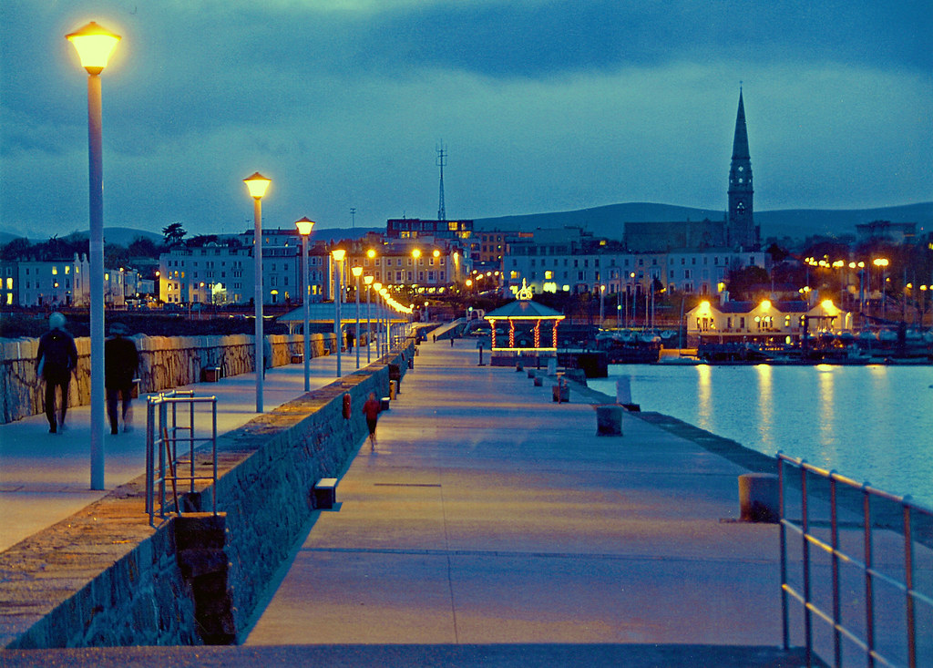
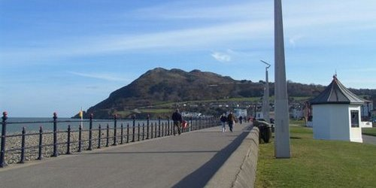
Bray beach and pier & Dun Laoghaire pier

Slide 12
Additional costs:
Leap Card (public transport): €19.50pp / €39 total (https://about.leapcard.ie/leap-visitor-card)
Accommodation: Private En-Suite Room (Airbnb): €102.50pp / €205 total (https://www.airbnb.ie/rooms/24930678?location=Dublin&adults=2&check_in=2020-05-15&check_out=2020-05-19&source_impression_id=p3_1587917053_B%2FSngLfLpxI5Ver8&guests=1)
Food & Drinks, Shopping and Souvenirs: 340pp / 680 total

